Slide 1
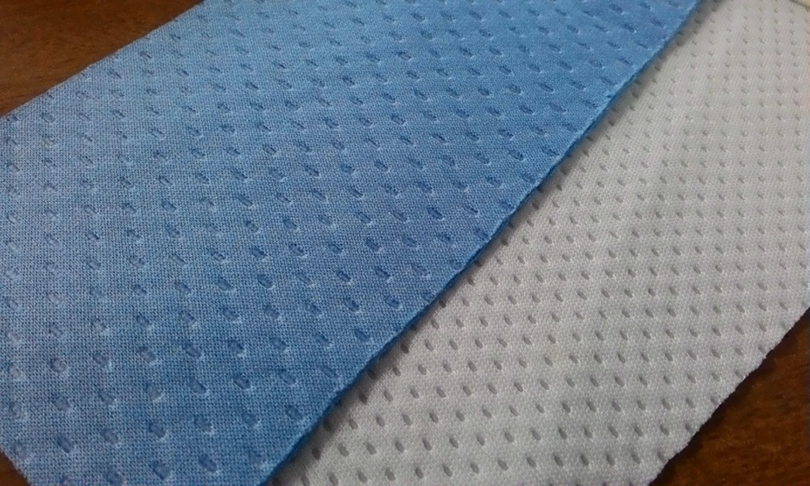
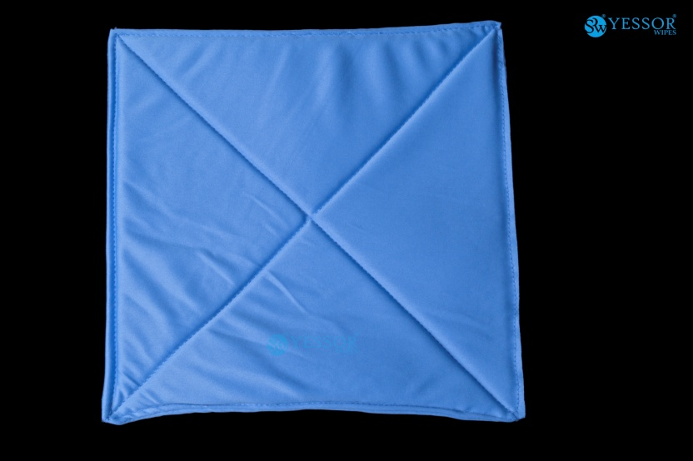
Lint free cloth 108 Lint free Mop
Explaining the absorption capacities of Lint free cloth 108 over traditionally stitched Lint free mop
Vs

Slide 2
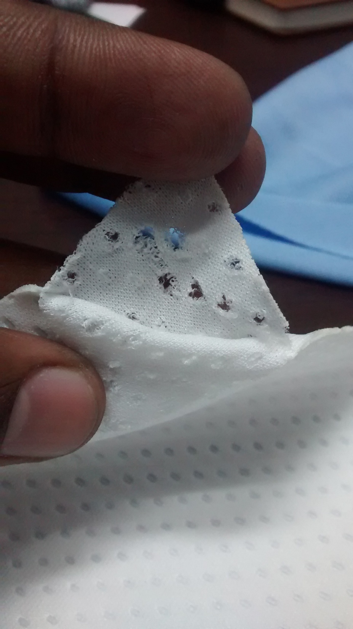
The lint free cloth 108 which is made up of 2 layers lint free cloth of very close bonded pineapple like structure allows better water holding and enables complete release of solvent.

Slide 3
Dry weight
108
MOP

Slide 4
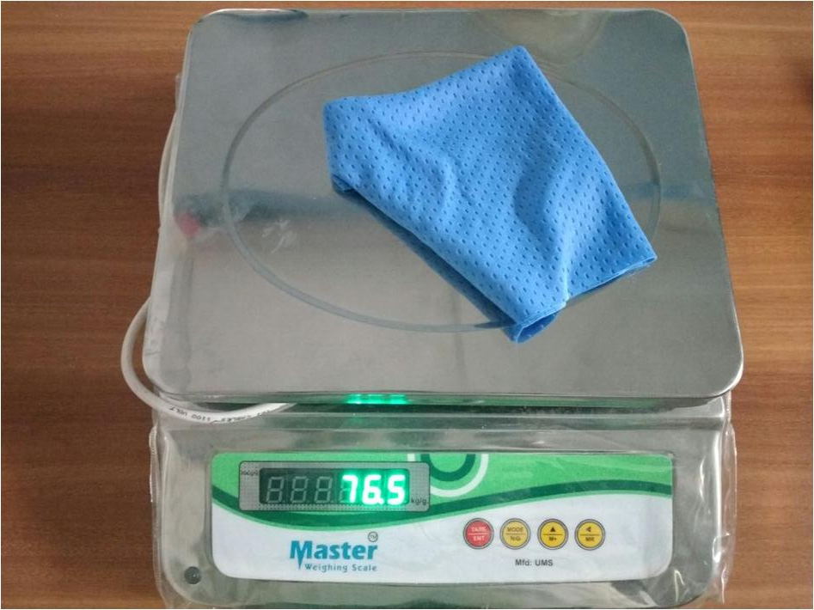
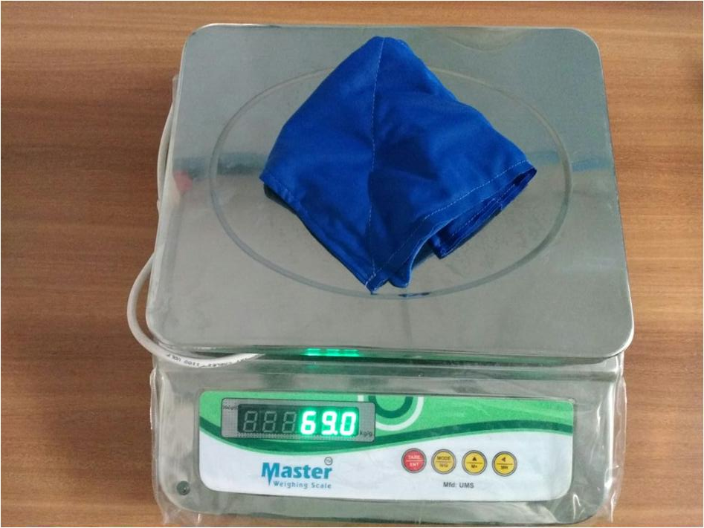
Wet weight
108
MOP

Slide 5
Absorbing capacity
108
MOP
Dry weight = 19 gms
Wet weight = 76.5 gms
Weight of water =57.5 gms
% of absorption = 302 %
Dry weight = 35 gms
Wet weight = 69 gms
Weight of water =34 gms
% of absorption = 97 %

Slide 6
Result of the study
Lint free cloth 108
Absorbs 3 times its own weight of water
Other merits:-
No lints due to sewing threads
No possiblity of contamination due to stuffing material (gada cloth) as in MOPs.
Can be made sterile
25% lesser cost compared to lint free mops.

